Slide 1
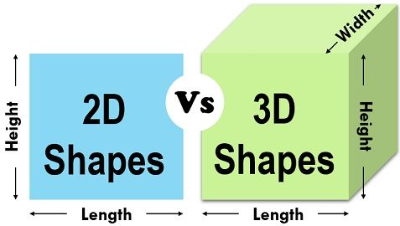
Projection methods are used to represent a 3D object in simple terms so that it can be understood more easily. It's used in mechanical drawing and design so that the structure created by a designer can be communicated to manufacturers.
PROJECTION
Projection Of Points
Projection Of Lines
Projection Of Planes

Slide 2
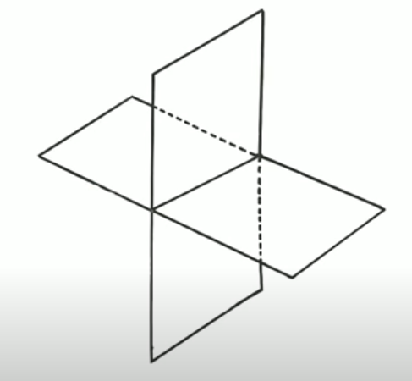
Quadrant System :
2D
3D
Y - Axis
2
( - + )
1
( + + )
X - Axis
Reference line
X - Axis
3
( - - )
4
( + - )
Y- Axis

Slide 3
Horizontal reference Plane
Vertical reference Plane
VP
Reference line
HP
X - Axis
HP
VP
Y- Axis

Slide 4
2
2
2nd Quadrant
VP
1
VP
1
2nd Quadrant
1st Quadrant
1st Quadrant
HP
HP
HP
HP
3
3
VP
VP
4
3rd Quadrant
4
3rd Quadrant
4th Quadrant
4th Quadrant

Slide 5
HP
VP
VP
HP
Rotate H.P in clockwise direction to 90⁰
HP
HP
VP
VP

Slide 6
Projection Of Points

Slide 7
2nd Quadrant
Above HP and behind of VP
VP
Quadrant wise position of any point
1st Quadrant
1. | Above HP and front of VP | 1st Quadrant
2. | Above HP and behind of VP | 2nd Quadrant
3. | Below HP and behind of VP | 3rd Quadrant
4. | Below HP and front of VP | 4th Quadrant
HP
Above HP and front of VP
HP
3rd Quadrant
Below HP and behind of VP
2nd Quadrant
1st Quadrant
VP
4th Quadrant
VP
Below HP and front of VP
Front view
HP
Top view
3rd Quadrant
Quadrant wise name of any point
HP
Front view (on VP) | a’ or b’
Top view (on HP) | a or b
Front
view
Top view
VP
4th Quadrant

Slide 8
Top view
2
VP
1
2nd Quadrant
1st Quadrant
HP
HP
Front view
3
VP
3rd Quadrant
4
4th Quadrant

Slide 9
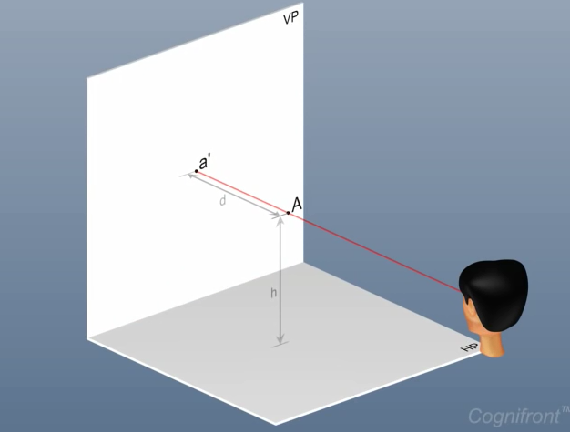
1. A point “A” is 40mm above H.P and 35 mm in front of V.P
1st Quadrant
Top view
VP
Distance (d)
a’
A
Front
view
HP
Height (h)
a
HP
VP

Slide 10
A point “A” is 40mm above H.P and 35 mm in front of V.P
1st Quadrant
To find out projection of a point “A”, place point A at the center of reference line
A point “A” is 40 mm above the HP
4
A point “A” is 35 mm front of VP
2
3
1
Identify Quadrant of a point
Front
view
Front
view
Front
view
Front
view
VP
VP
Top view
VP
Top view
VP
Top view
Top view
d
d
d
d
a’
a’
A
A
A
A
HP
HP
HP
h= 40mm
HP
h= 40mm
h
h
h
h
HP
HP
HP
d= 35mm
HP
a
VP
VP
VP
VP

Slide 11
5
Rotate H.P in clockwise direction to 90⁰
Steps to draw projection of a given point A
1. Consider given rectangle is a drawing sheet or note book page
Front
view
HP
2. Draw a reference line XY with suitable length (assume length for XY)
VP
Top view
d
VP
3. Plot a pint A at the center of reference line.
a’
A
a’
4. Plot front view of a point A is 40mm above the reference line and assign name a’
VP
HP
h= 40mm
5. Plot top view of a point A is 35mm below the reference line and assign name a
h
h= 40mm
a’
d= 35mm
HP
a
d= 35mm
h= 40mm
HP
X
A
Y
VP
VP
d= 35mm
a
HP

Slide 12
1. A point “A” is 40mm above H.P and 35 mm behind of V.P
2nd Quadrant
Top view
Distance (d)
A
VP
Height (h)
a’
Front
view
HP
a
HP
VP

Slide 13
A point “A” is 40mm above H.P and 35 mm behind of V.P
2nd Quadrant
To find out projection of a point “A”, place point A at the center of reference line
A point “A” is 40 mm above the HP
4
A point “A” is 35 mm front of VP
2
3
1
Identify Quadrant of a point
Front
view
Front
view
A
Front
view
A
Front
view
A
A
d
d
d
VP
d
VP
VP
VP
h
a’
h
a’
h
h
a
h= 40mm
HP
HP
HP
HP
h= 40mm
Top view
d= 35mm
Top view
Top view
Top view
HP
HP
HP
HP
VP
VP
VP
VP

Slide 14
5
Rotate H.P in clockwise direction to 90⁰
Steps to draw projection of a given point A
1. Consider given rectangle is a drawing sheet or note book page
Front
view
HP
2. Draw a reference line XY with suitable length (assume length for XY)
VP
d
VP
3. Plot a pint A at the center of reference line.
a’
a’
4. Plot front view of a point A is 40mm above the reference line and assign name a’
A
d= 35mm
VP
HP
a
h= 40mm
5. Plot top view of a point A is 35mm below the reference line and assign name a
h
h= 40mm
d= 35mm
a’
Top view
HP
a
h= 40mm
HP
d= 35mm
X
A
Y
VP
VP
HP

Slide 15
A point “S” is 50mm above H.P and 40 mm in front of V.P
A point “P” is 30mm above H.P and 40 mm behind of V.P
A point “Q” is 25mm below H.P and 30 mm in front of V.P
A point “R” is 45mm below H.P and 35 mm behind of V.P

